Slide 1
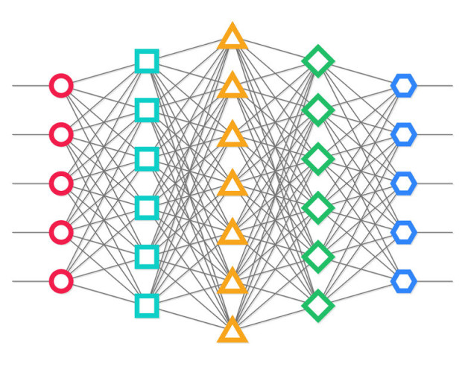
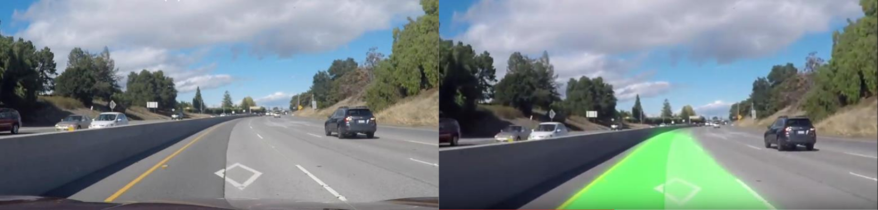
Lane Detection with CNN & RNN
Shen Chen
Spencer Pozder
Yang Liu

Slide 2

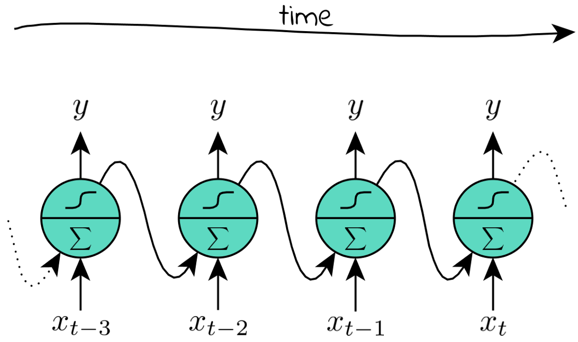
Overview: Our Goals & Achievement
Framework we used: Tensorflow
Main Approach: CNN + RNN
Model of CNN we used: SegNet
Model of RNN we used: Self-Looping Neuron
Preliminary Research
Data Processing
Models & Training
Output & Validation

Slide 3
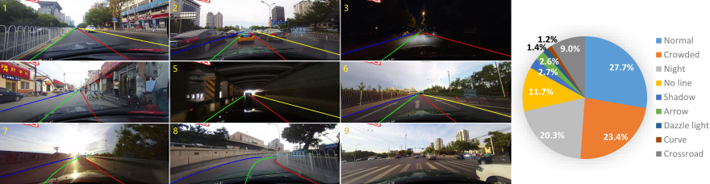
Others’ Work
CULane Dataset:
A lane dataset collected by The Chinese University of Hong Kong
Have lane data from ideal conditions and challenging conditions like night and bright light
Preliminary Research
Data Processing
Models & Training
Output & Validation

Slide 4
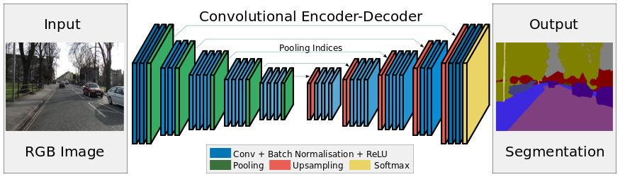
Others’ Work
Michael Virgo’s Lane Detection Project:
Used SegNet, which is good at separating objects in images
Used Keras and own labeled data
Preliminary Research
Data Processing
Models & Training
Output & Validation

Slide 5
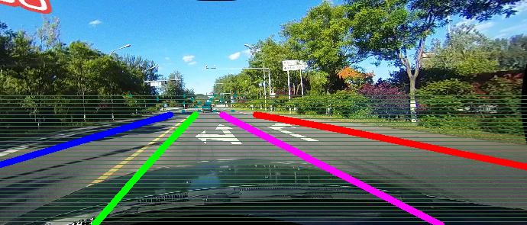
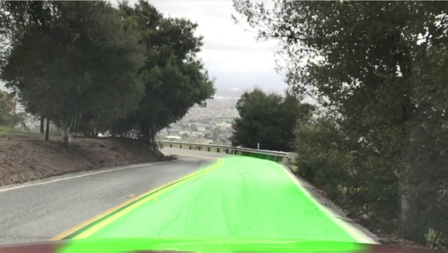
Setting up the dataset to interface with model
Modify original labels to our labels
The original labels are based on feature boundary points and line-representations of all lanes
Our labels are based on areas of the current lane that the vehicle is in
Preliminary Research
Data Processing
Models & Training
Output & Validation

Slide 6

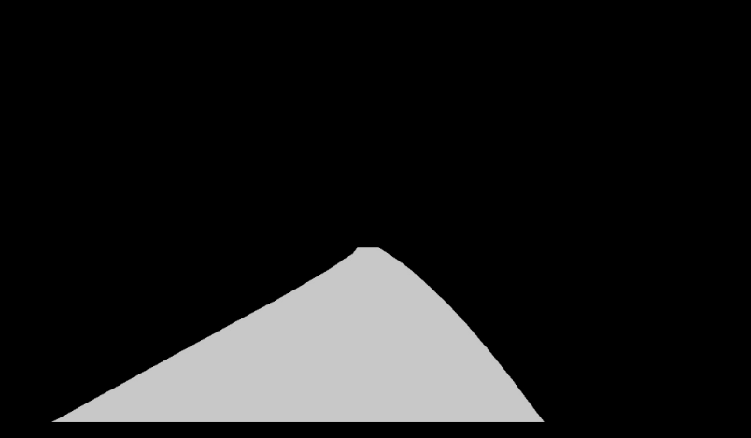
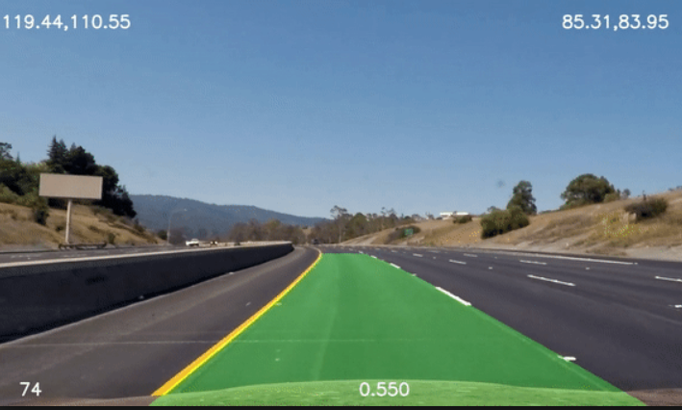
Setting up the dataset to our model’s interface
Lane boundary feature points
Filled Lane Label Images
Training Model
Raw images
1620 * 840
Shrinked images
160 * 80
Preliminary Research
Data Processing
Models & Training
Output & Validation

Slide 7
Structure of Our Model
Convolutional Layers
Deconvolutional Layers
Recursive Network
Conv-8
Conv-64
Conv-16
Conv-64
F(x) = tanh(x)
Conv-16
Conv-64
Lane Prediction
Conv-32
Conv-64
Conv-32
Conv-64
Conv-64
Conv-64
Conv-64
Conv-64
Preliminary Research
Data Processing
Models & Training
Output & Validation

Slide 8
Example Input video
Preliminary Research
Data Processing
Models & Training
Output & Validation

Slide 9
Example Output video
Preliminary Research
Data Processing
Models & Training
Output & Validation

Slide 10
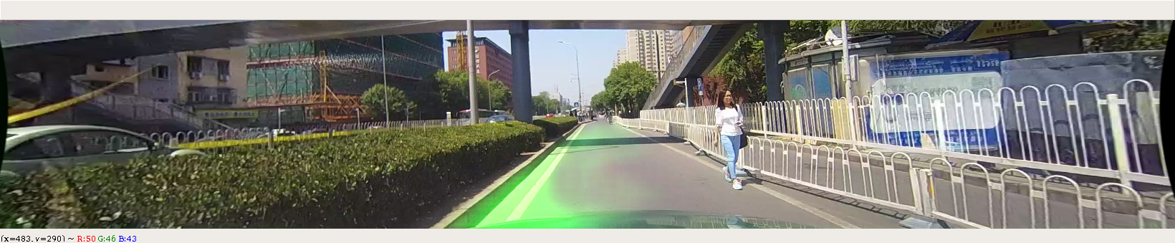
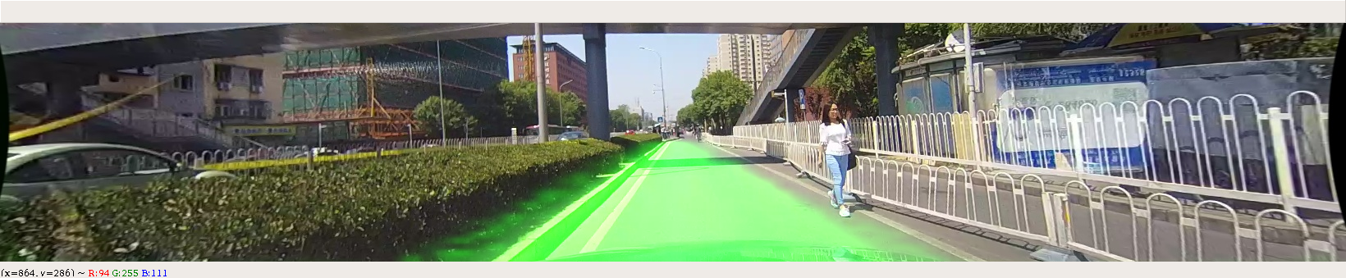
Output Frames for Comparison
CNN Only
RNN + CNN
Preliminary Research
Data Processing
Models & Training
Output & Validation

Slide 11
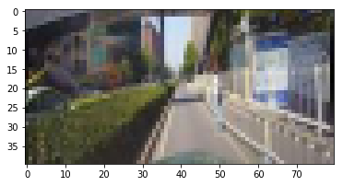
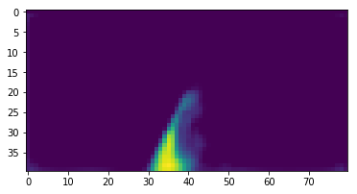
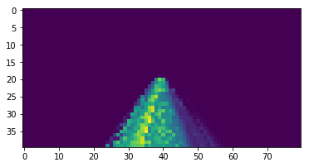
Training Result of both CNN & RNN Models
CNN:
Do prediction depending only on the geometry of the current image.
May have better understanding of the lane in certain frames
Performs bad in many challenging cases like going across shadow of a bridge
RNN:
Predict lanes with help of recurrence
May have better understanding of the lane in frames with less visual information than previous frame(s)
Helps to perform better in challenging situations
Preliminary Research
Data Processing
Models & Training
Output & Validation

Slide 12
THANK YOU

